Slide 1
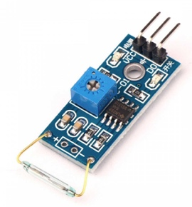
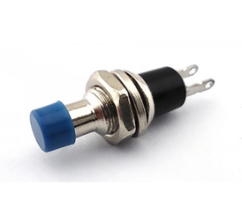
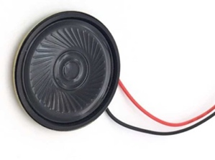
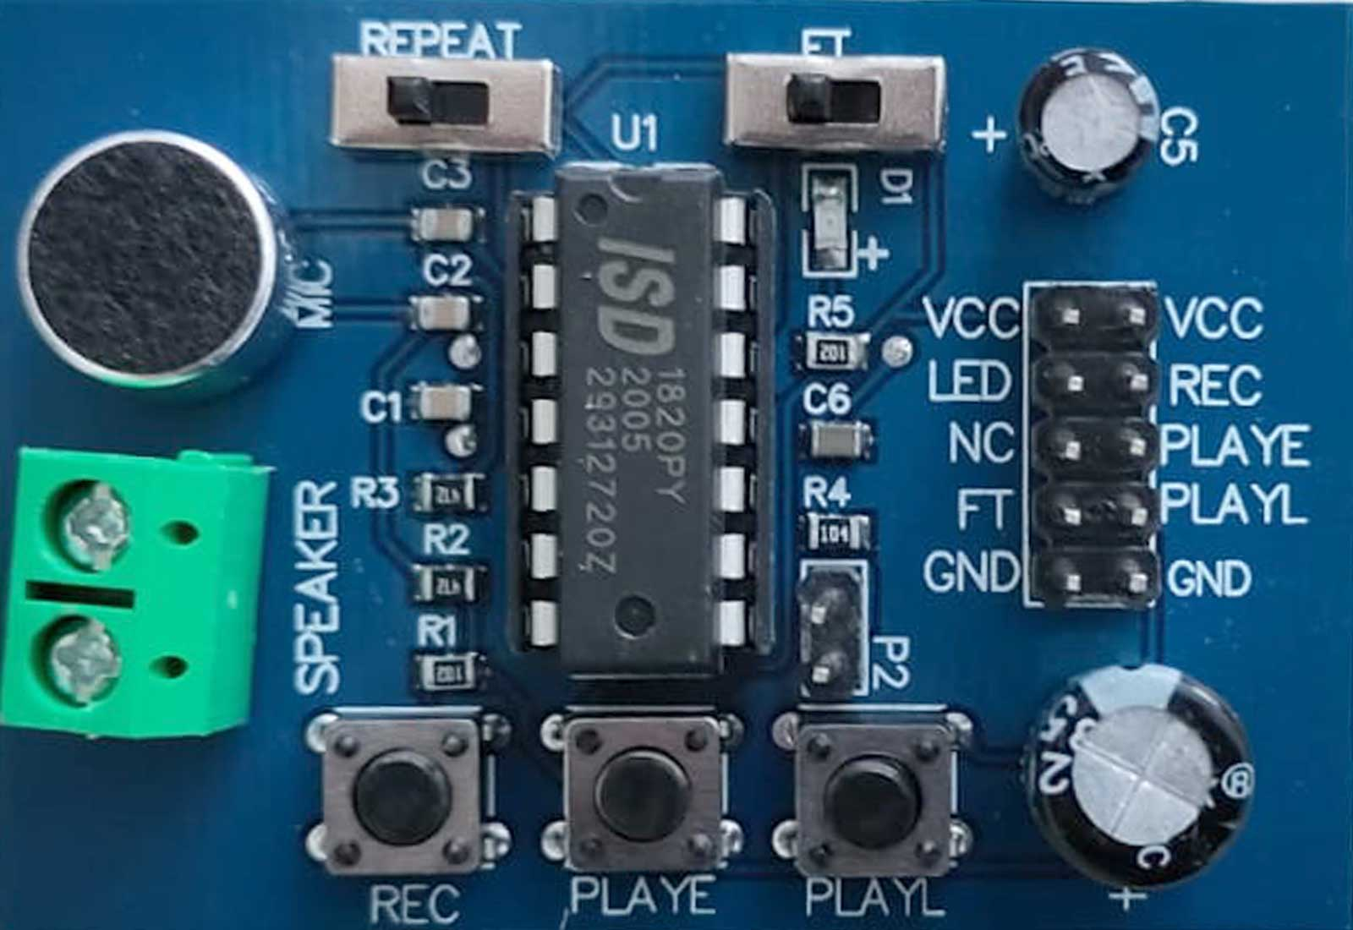
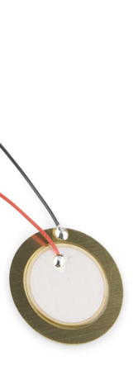
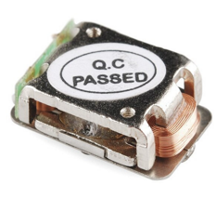
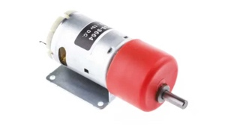
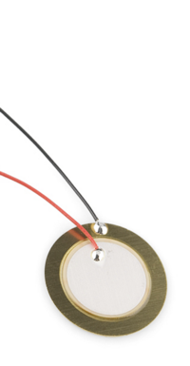
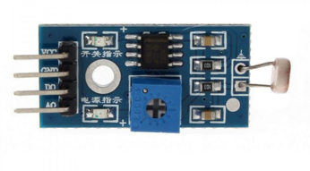
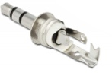
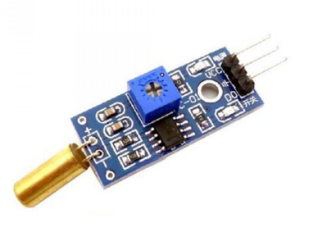
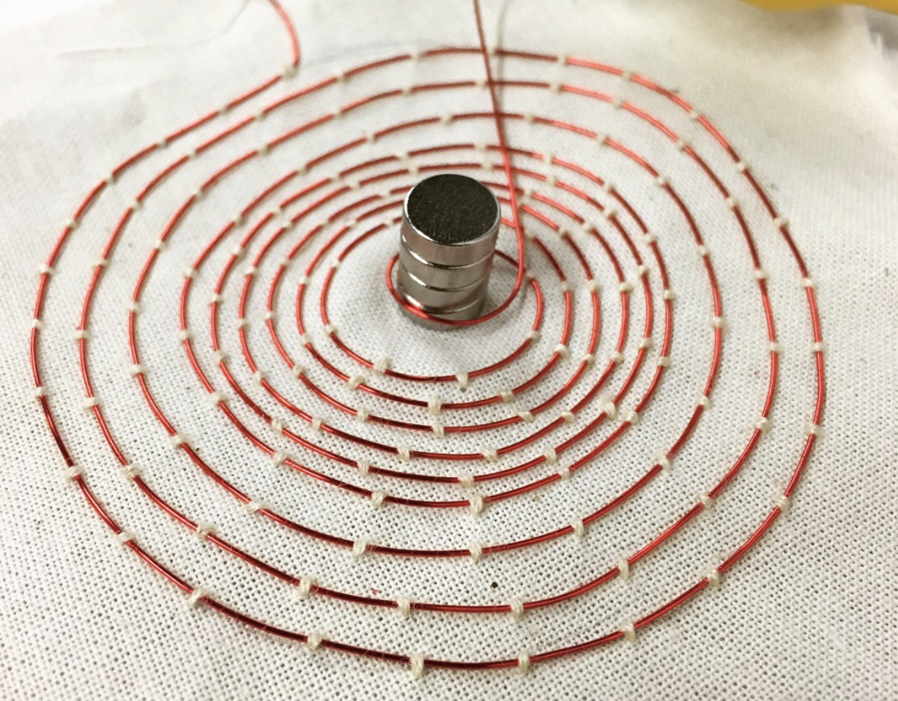
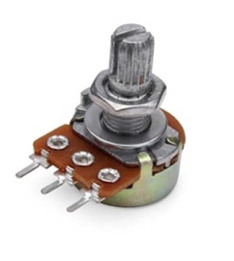
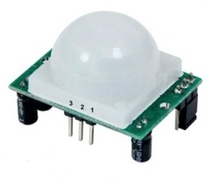
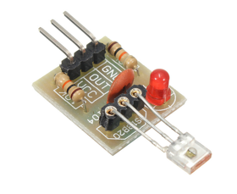






feedthru
mic input directly to speaker
3.3-5V
microphone
get close!
repeat
pins to external switches
any DIY on/off switch works
rec ←→ vcc = record
playE ←→ vcc = play once
playL ←→ vcc = play while pressed
speaker +
-
8 Ω speaker OR
piezo transducer OR bone conductor OR jack to speaker OR
DIY speaker coil
gnd
on-board switches rec (record)
playE (play track once)
playL (play while pressed)
p2 jumper
10K default = 10 sec record time
500K pot to play w distorted sounds
ISD1820 Recording Module

Slide 2
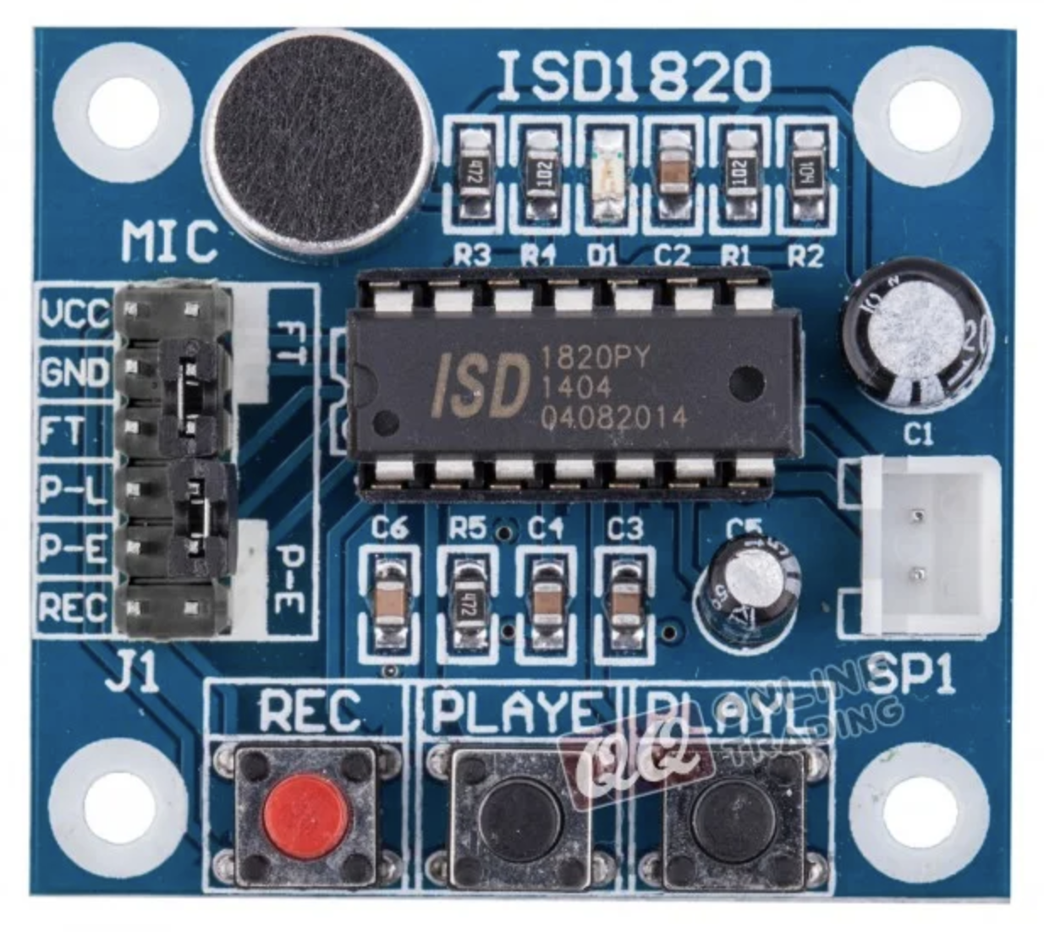
microphone
Power – 3.3-5V
Power – 3.3-5V
feedthru
playback while pressed
playback once
speaker cable
record while pressed
Connect playback/record pins to any switch or sensor and VCC
Tiny jumpers to activate feedthrough or repeat modes
Module we have today

Slide 3
audio outputs

Slide 4
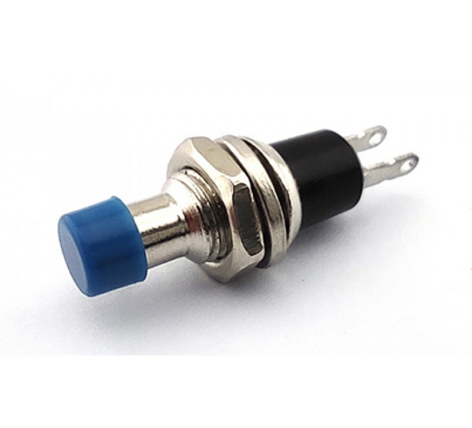





3.3-5V
any on/off switch
speaker
GND
ISD1820 + 8 ohm speaker

Slide 5
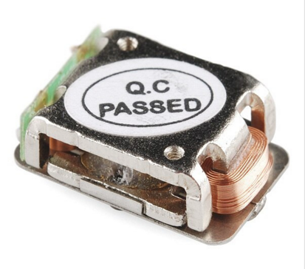
3.3-5V
any on/off switch
bone conductor transducer
GND
ISD1820 + bone conductor speaker

Slide 6
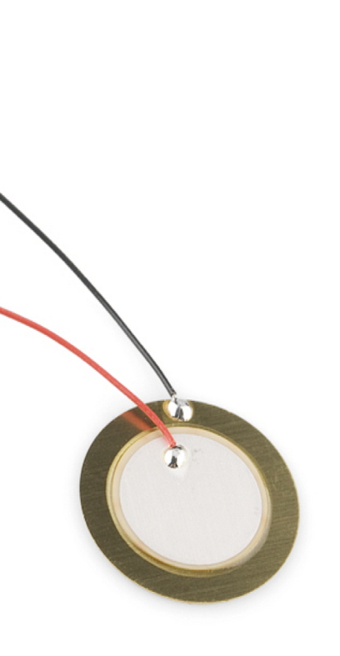
3.3-5V
any on/off switch
piezo transducer
GND
ISD1820 + piezo speaker
Put between your teeth or on jawbone to hear sound

Slide 7



3.3-5V
any on/off switch
3.5 mm audio jack
GND
ISD1820 + 3.5mm jack
Then connect to any battery powered speaker for bigger sound

Slide 8
amplifier

Slide 9
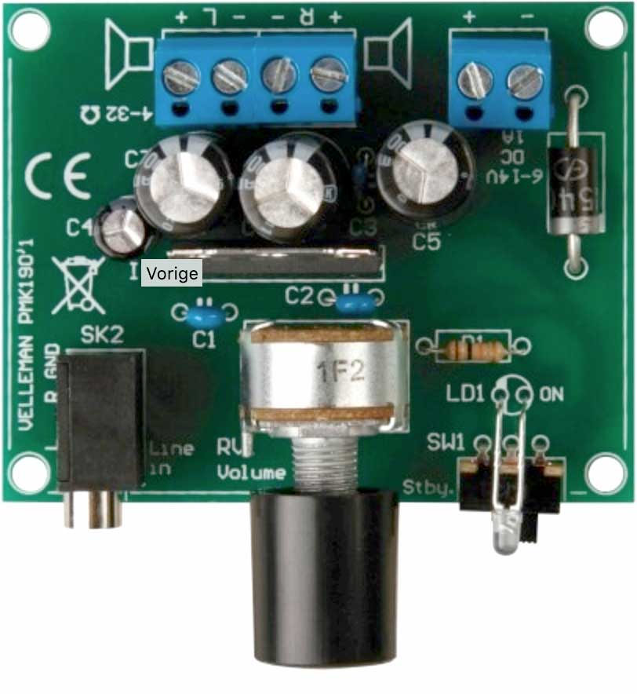







6 - 14V
shared GND!
3.3-5V
any on/off switch
any 4-32 ohm speaker
3.5mm mono jack
amplifier for louder sound: Velleman PMK190’1 + ISD1820

Slide 10
distortion

Slide 11



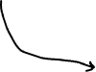
3.3-5V
speaker (or other output device)
any on/off switch
GND
default when jumper is used
Ω | Record time | Sample rate | Bandwidth
80K | 8 secs | 8 KHz | 3.4 KHz
100K | 10 secs | 6.4 KHz | 2.6 KHz
120K | 12 secs | 5.4 KHz | 2.3 KHz
160K | 16 secs | 4.0 KHz | 1.7 KHz
200K | 20 secs | 3.2KHz | 1.3 KHz
250K or 500K potentiometer
ISD1820 + 500k pot
on p2: distorts the sound

Slide 12
3.3-5V
speaker (or other output device)
any on/off switch
GND
default when jumper is used
Ω | Record time | Sample rate | Bandwidth
80K | 8 secs | 8 KHz | 3.4 KHz
100K | 10 secs | 6.4 KHz | 2.6 KHz
120K | 12 secs | 5.4 KHz | 2.3 KHz
160K | 16 secs | 4.0 KHz | 1.7 KHz
200K | 20 secs | 3.2KHz | 1.3 KHz
0 Ω 50K Ω 100K Ω 200K Ω
DIY variable resistor
make with conductive paint

Slide 13
triggers

Slide 14
3.3-5V
any on/off switch
speaker (or other output device)
GND
ISD1820 + light sensor

Slide 15
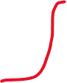



conductive material
3.3-5V
conductive material
speaker (or other output device)
GND
ISD1820 + light sensor

Slide 16
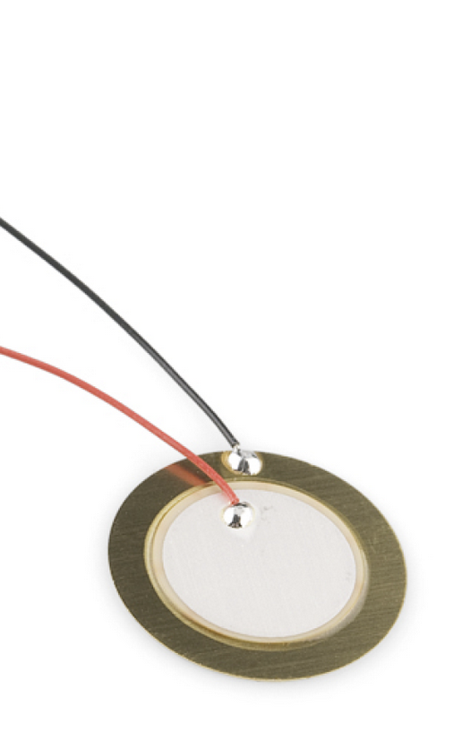
3.3-5V
speaker (or other output device)
GND
ISD1820 + Piezo transducer
Press, bend or knock trigger

Slide 17

3.3-5V
speaker (or other output device)
GND
ISD1820 + DC motor
Type e.g. 4.5-15V with gearbox

Slide 18


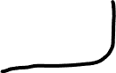

3.3-5V
sensitivity pot
speaker (or other output device)
GND
ISD1820 + light sensor

Slide 19

3.3-5V
sensitivity pot
speaker (or other output device)
GND
ISD1820 + tilt switch
also useful as record switch!

Slide 20
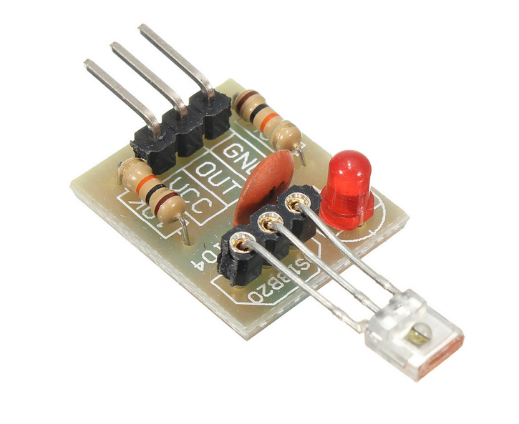
sensor eye
3.3-5V
speaker (or other output device)
GND
ISD1820 + red laser sensor

Slide 21
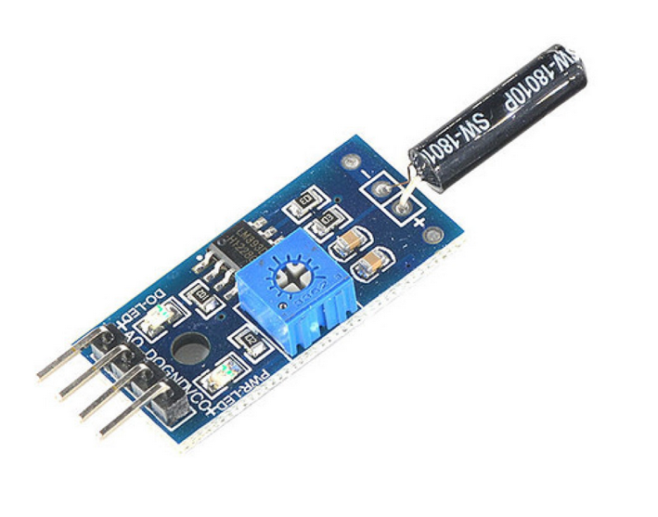
3.3-5V
sensitivity pot
speaker (or other output device)
GND
ISD1820 + vibration sensor

Slide 22
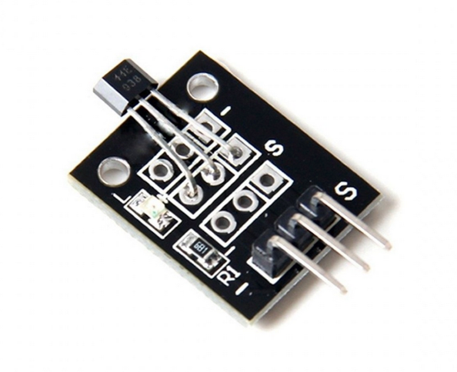
magnet
3.3-5V
speaker (or other output device)
GND
ISD1820 + hall effect sensor

Slide 23

magnet
3.3-5V
sensitivity pot
speaker (or other output device)
GND
ISD1820 + reed switch

Slide 24

3.3-5V
speaker (or other output device)
GND
ISD1820 + motion sensor
Needs min 4.5V (might not be reliable at 3.3V)
Tx pot to adjust delay of trigger
Sx pot to adjust sensitivity (distance)

